Slide 1
King County House Prediction

Slide 2
Business Understanding
A real estate agency seeks to provide homeowners with the requisite information which will in turn aid them in buying and/or selling their homes.
r.

Slide 3
OBJECTIVES
In providing the service of property evaluation, we intend to provide constructive advice to stakeholders about current and future house prices by building by developing a model that predicts the price of these houses.
In general we would like to conduct an analysis to determine which factors have the greatest influence on the estimated value of the houses and by how much. This will help in determining where to focus more effort in order to complete this project successfully.

Slide 4
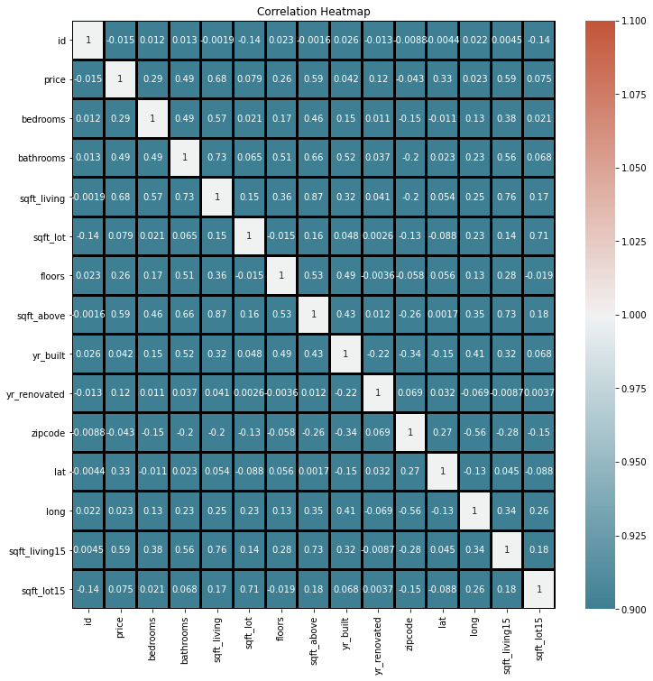
Correlation Heatmap
Heatmaps are great to detect this kind of situations and in problems dominated by feature selection, like ours, they are an essential tool
1

Slide 5
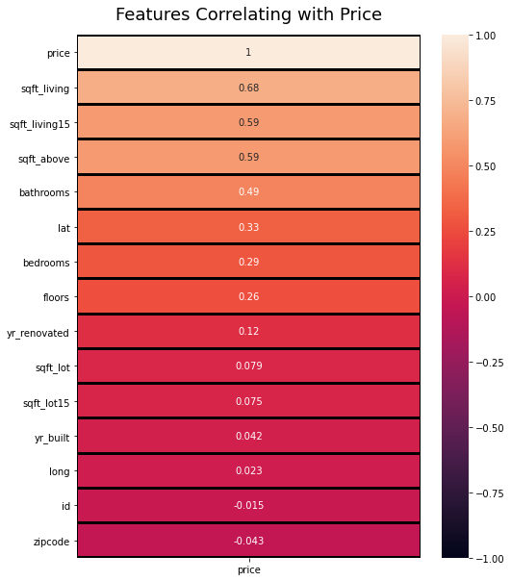
According to our heatmap table, these are variables most correlated with 'price'.
"sqft_living", "sqft_above" and "sqft_living15" are strongly correlated with "price".

Slide 6
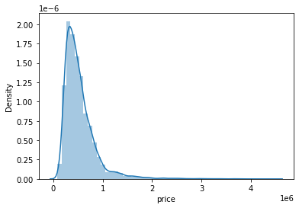
Price Column Distribution
Observation from the distribution
The plot shows that the price column is positively skewed, indicating that our data is not normally distributed. Thus, it has leptokurtic kurtosis.

Slide 7
Linear Regression Model Results
The third model where all the predictor variables were were used explains about 63% of variance in price unlike the previous models that explains about 24%, 36% of variance respectively.
All the models are statistically significant having a p_value of less than 0.005
The value of our r_squared constantly increase as we add more predictors.
The last model would be an ideal in predicting the current and future prices of the house.

Slide 8

Recommendations
Coefficients such as house condition, bedrooms, bathrooms, and sqft_living, in general increasing the acreage of the property should be considered because they have a positive impact on prices.
I could very well recommend that the Agency use the last model because it has a higher r squared value of 0.63, which translates to 63% model accuracy.
If the Agency wants to increase its sales, I recommend that they focus on building average grade 7 houses because the majority of buyers prefer to buy this type of houses.

